Slide 1

CAV RP
Web CAV
Repairable Portal Access
Presented by:
Diego Reynoso
Janet Anderson
Sam Rhoads
1-3 SEP 2026

Slide 2
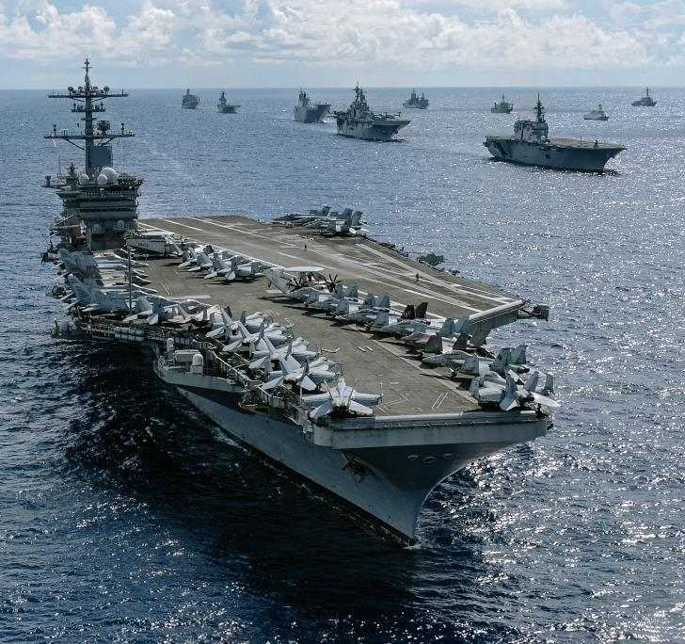
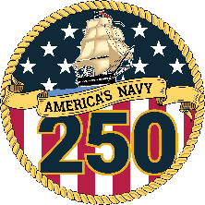
Outline
Repairable Portal (RP) Road to Access
Common Access Issues
Questions

Slide 3
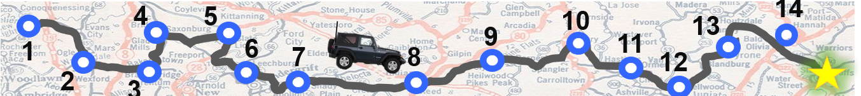
RP Road to Access
1 | Obtain Public Key Infrastructure (PKI) Certificate. |  | 8 | UM Team reviews documents.
2 | Complete DoD Cyber Awareness Training. |  | 9 | UM Team forwards SAAR for additional processing.
3 | Complete System Authorization Access Request (SAAR) form. |  | 10 | Completed SAAR is returned to UM team who begin RP Account build out, submitting the Access Enforcer request (AER) for RP roles. Request goes through 6 stage approval process.
4 | Complete Navy User Agreement (UA) form. |  | 11 | Business Systems Center review the AER & uploaded Documents as a part of the stage 2 approval process.
5 | Submit the DoD Cyber Awareness Training Certificate, UA and SAAR forms to your CAV Analyst via DoD Safe Website. |  | 12 | RP Account gets created by Navy ERP as a part of the AER request stage 3 approval. Vendor is notified their account is created.
6 | CAV Analyst reviews documents and completes their portion of the SAAR & Conducts RP Training. |  | 13 | Access Enforcer request completes additional processing; auto generated email is sent stating the request is closed.
7 | CAV Analyst forwards documents to the User Management (UM) Team. |  | 14 | UM Team updates RIC table in system and updates training records.
 |  |  | 15 | System Access is granted 24-48 hours after Vendor gets AER closure email.
Vendor
UM Team
Insert photo or graphic here
CAV Analyst
AVERAGE TIME IT TAKES TO GET ACCESS TO THE SYSTEM IS 15 BUSINESS DAYS

Slide 4



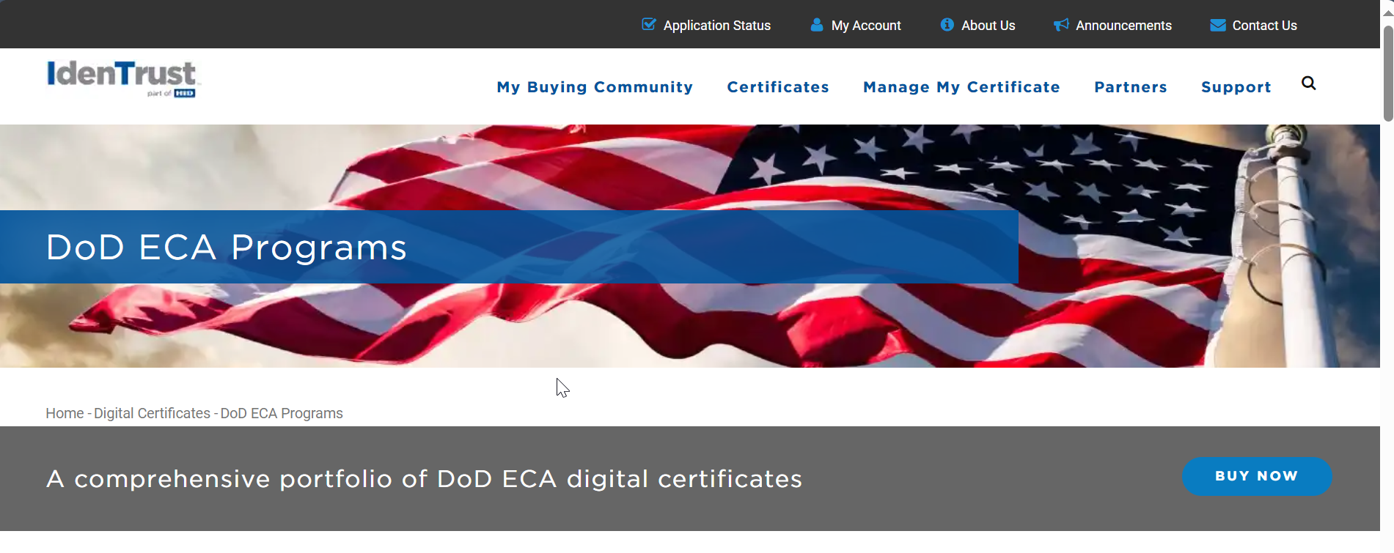
RP Road to Access
Step 1 – Purchase Your PKI
You want to purchase the ECA Medium Token Assurance certificate for a term of 1-3 years.
https://eca.orc.com/
https://www.identrust.com/

Slide 5
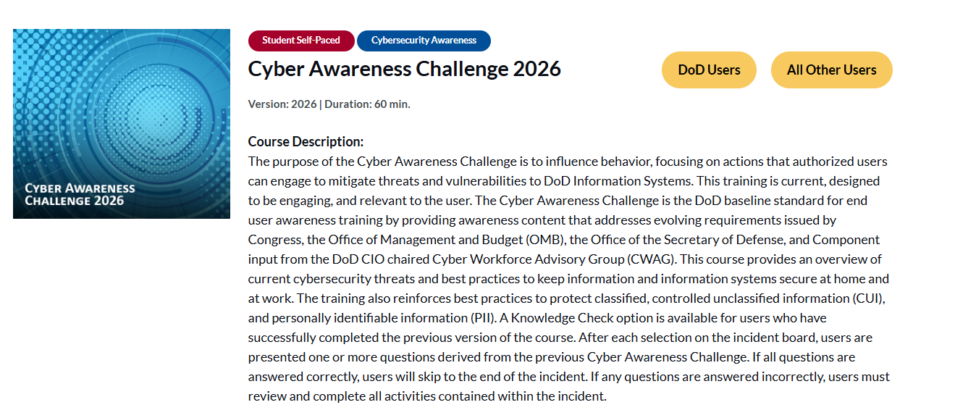
RP Road to Access
Step 2 – Complete DoD Training
You need to successfully pass the DoD Cyber Awareness Challenge Training and save your Certificate of Completion as a PDF file.
This certificate is good for 1 year and will need to be completed annually for the duration of your access to the system.
https://www.cyber.mil/cyber-awareness-challenge

Slide 6
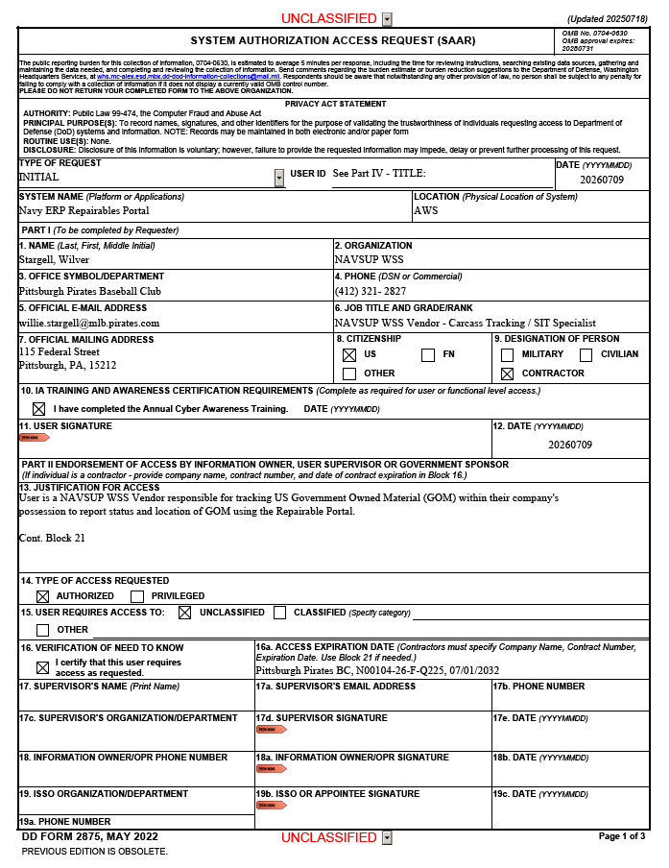
RP Road to Access
Step 3 – Complete SAAR Form
Vendor is responsible for filling in Part 1
  Blocks 1-12 & Block 16a.
  Please do not adjust or edit any prepopulated data.
The CAV Analyst & other NAVSUP Government personnel complete the other blocks.
  Before the SAAR gets the last signature, it will be reviewed by 5 different people / teams.
The NAVSUP Government personnel who review this form:
  Are VERY PARTICULAR with how the form is completed.
    They will verify the information you supplied as being correct and;
    They will not hesitate to reject or kick the form back for what may seem like the most trivial of errors.
The following slides address how your SAAR can sail through the process.

Slide 7
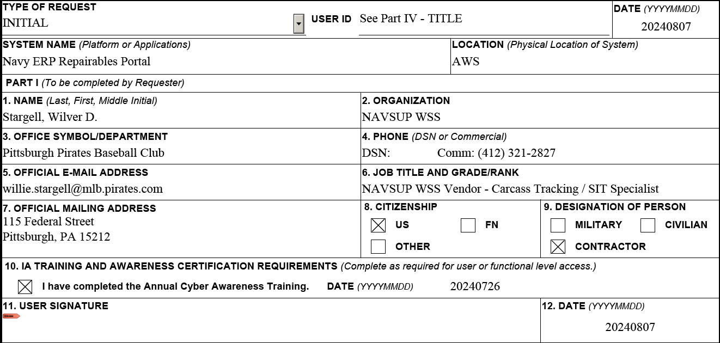
RP Road to Access
Step 3 – Complete SAAR Form
This date must be completed. It can be the same as or before the date the SAAR is signed in block 12 but it must not be after the date in block 12.
Ensure your name matches your PKI certificate.
Nicknames or abbreviated names should not be used.

Slide 8
RP Road to Access
Step 3 – Complete SAAR Form
Type your Company Name as it appears on the NAVSUP contract. This name should match what is used in Block 16A.
“Comm” means commercial. Type your phone number after “Comm.”
Type your company furnished email address and mailing address.
US is checked as a default, if you are not a US citizen, please check “FN” for Foreign National.

Slide 9
RP Road to Access
Step 3 – Complete SAAR Form
Your DoD Cyber Awareness Training Certificate Date should be current.
Current is under 365 days old and not about to expire within the next 90 days.
This date must be on or before the date the user signs the SAAR.

Slide 10
RP Road to Access
Step 3 – Complete SAAR Form
Block 12 must be completed before block 11; otherwise block 12 will lock.
This date should match the date in your digital signature.
Digitally sign your SAAR using your PKI certificate.

Slide 11
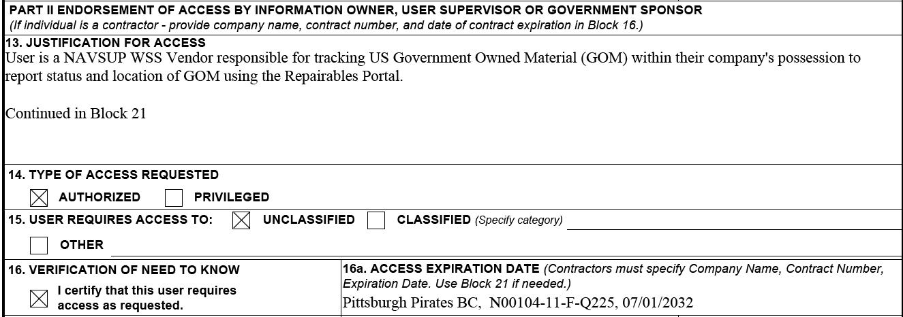
RP Road to Access
Step 3 – Complete SAAR Form
Type company name, contract number and expiration date.
Please use the longest signed contract between NAVSUP WSS & your company.
SAAR will not be accepted if the contract expiration date is within 60 days.

Slide 12

RP Road to Access
Reasons for Rejection
Contract information is incorrect.
DoD Cyber Awareness Training Certificate isn’t current or doesn’t match what’s listed in Block 10.
SAAR is not signed with ECA certificate.
Dates – missing in Date Block or they’re misaligned.
“Other” is checked in Block 8 Citizenship.
THE
REASONS YOUR
SAAR GETS REJECTED

Slide 13
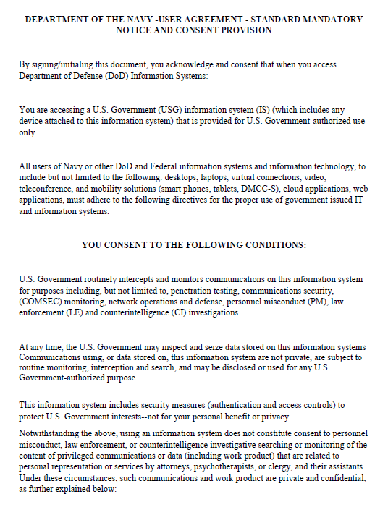
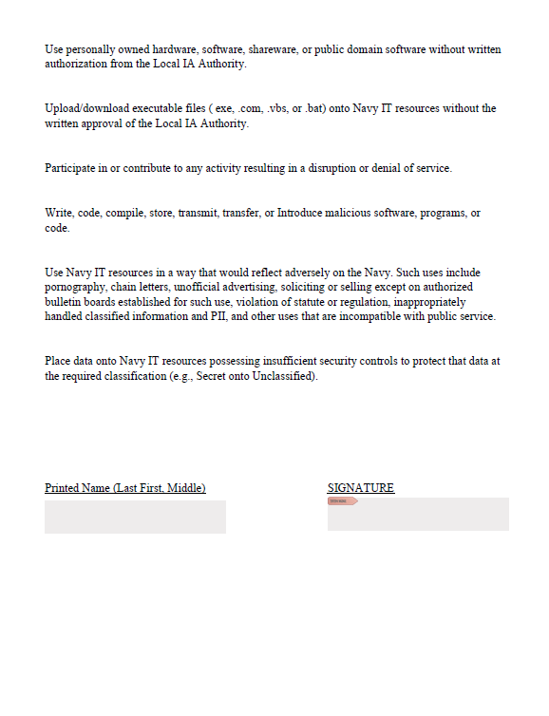
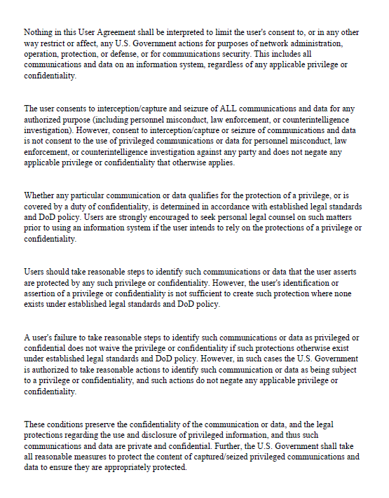
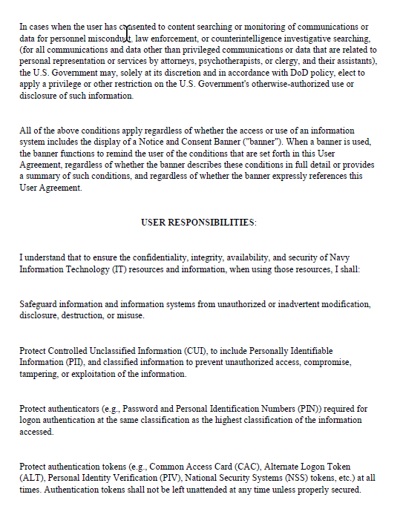
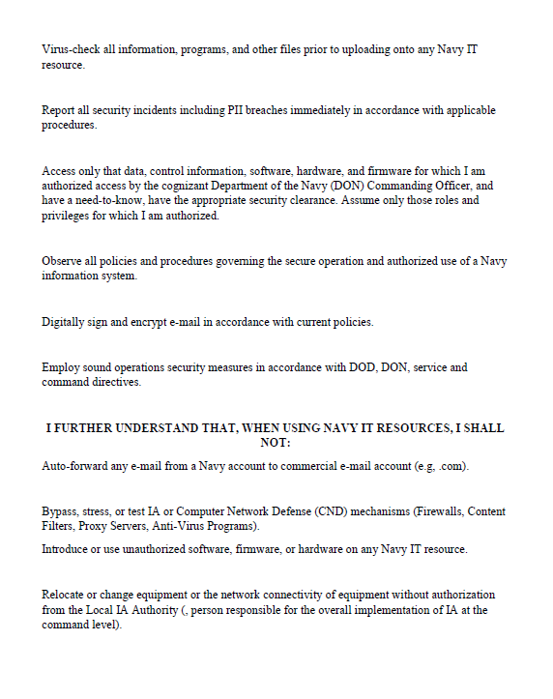
RP Road to Access
Step 4 – Complete User Agreement
Vendor is responsible for reading all 5 pages of the form and completing it by:
  Typing your name on the last page in the name block
  Electronically signing it with your PKI certificate.
Save form as PDF file.

Slide 14

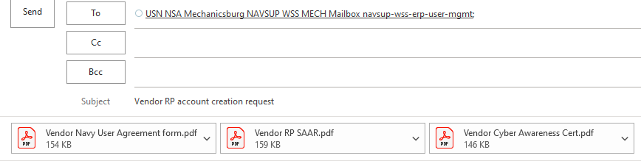
RP Road to Access
Step 5 – Submit Completed Documents
 | New Repairables Portal Account Check List
 | Obtained / Have ECA Medium Token Assurance Certificate.
 | Completed Current Fiscal Year DoD Cyber Awareness Challenge Training & Saved Certificate as PDF.
 | Completed SAAR Form and digitally signed with PKI certificate.
 | Read through and digitally signed with your PKI certificate the Navy User Agreement saving as a PDF.
 | Submitted all the required PDF documents (SAAR form, DoD Cyber Awareness Challenge Certificate & Navy User Agreement) to your CAV Analyst via DoD Safe - https://safe.apps.mil/

Slide 15
RP Road to Access
Step 6 &7 – CAV Team Processes Paperwork
CAV Analyst receives the paperwork from the Vendor and completes their portion of the SAAR form:
  Complete Blocks 17 as the Supervisor & sign as the supervisor.
  Create the Vendor’s PERNR in Navy ERP and put that number on the SAAR form in Block 21.
  List the RICs associated with the vendor in Block 21.
Forwards SAAR to the UM team for processing with the Navy User Agreement and DoD Cyber Awareness Challenge Certificate.
CAV Analyst conducts RP related Training.

Slide 16
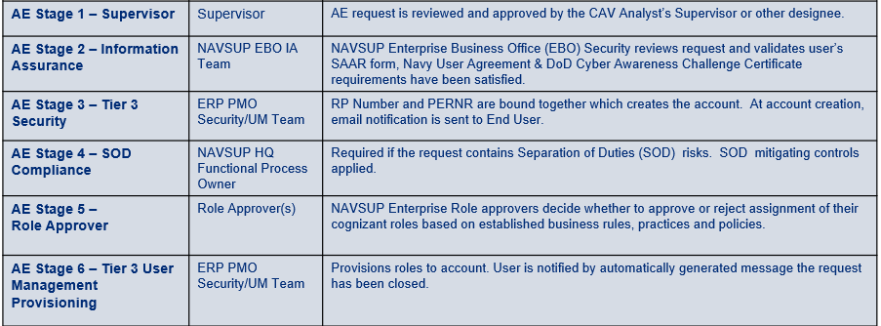

RP Road to Access
Step 8, 9 &10 – UM Team Processes Paperwork
UM Team receives the submission from the CAV Analysts and reviews for errors.
Forward good SAARs to WSS Security Team & Information Systems Security Team for signatures.
Returns not so good SAARs to CAV Analyst for corrections.
Generate the RP number for each vendor and upload documentation into the RP User Database.
UM team submits Access Enforcer (AE) Request to establish RP Account.
Access Request
Workflow

Slide 17
RP Road to Access
Step 11 – BSC Security Review
Account Request is routed to the NAVSUP Business Systems Center (BSC) Information Assurance team for processing.
BSC team reviews documentation in database against the account creation request. Account request is passed to the next stage for processing with correct forms & documentation on file.

Slide 18
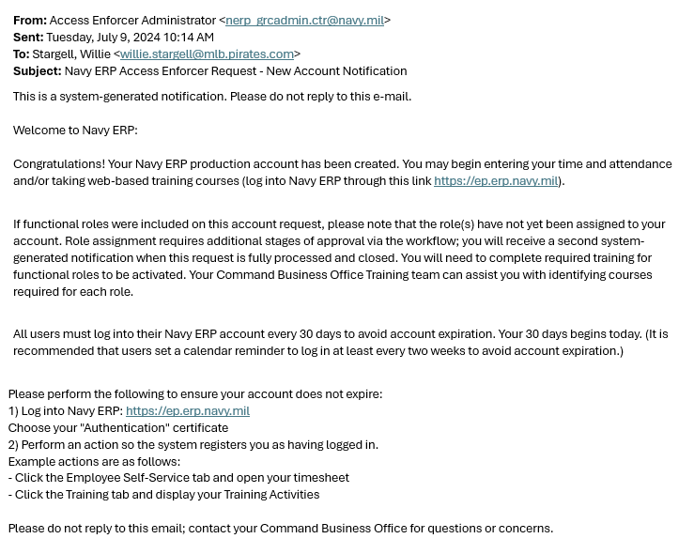
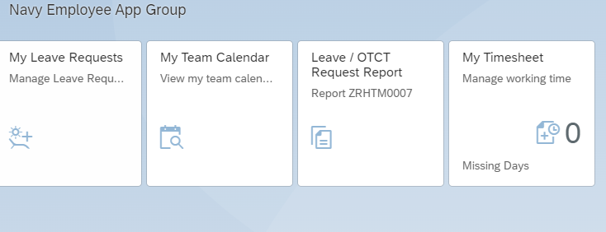
RP Road to Access
Step 12 – RP Account is Created
Once your account is created, you’ll receive a New Account Notification system generated email.
While your account has been created, your access has not been established yet.
The links in any system generated email are not going to work for you as an RP user. You need to use the following link: https://external-portal.erp.navy.mil/
You should log in within 7 days of getting this message to keep your account from locking.
The screen should look like this:

Slide 19
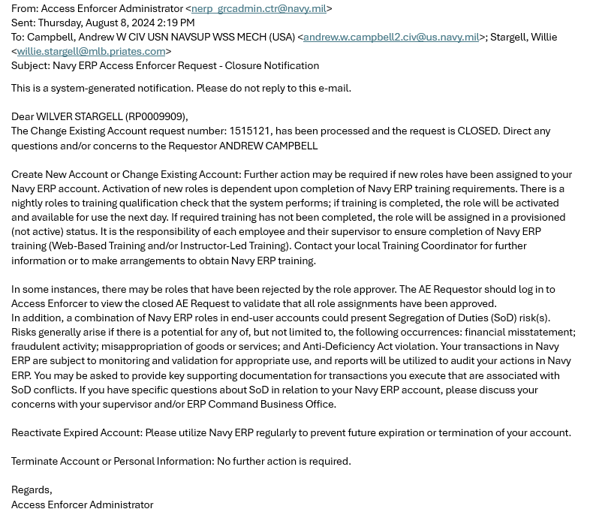
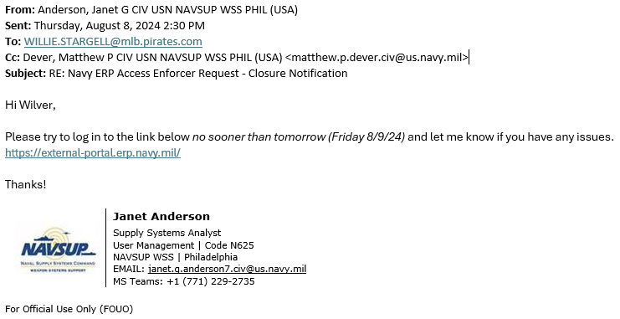
RP Road to Access
Step 13 & 14 – AE Closes/ RIC Table Update
The Closure Notification system generated message informs you the request to create your account with all the privileges and access has completed. Your access is still not established.
The RICs still need assigned to your account and that is a manual process.
Please allow 24 - 48 hours following this email for your access to be granted.

Slide 20
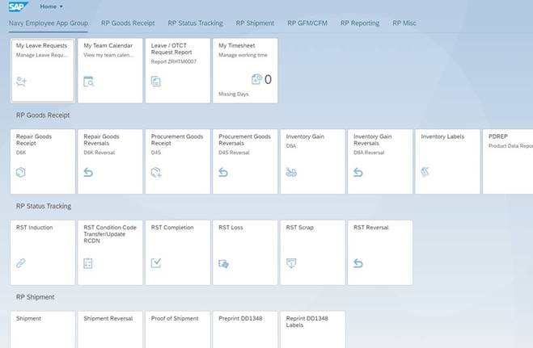

RP Road to Access
Step 15 – Access Granted
Log Into Repairable Portal via: https://external-portal.erp.navy.mil/
Microsoft Edge is the preferred / best browser to use for the RP tool.

Slide 21

RP Road to Access
About Your RP Account
You must log into the system at least once every 30 days to keep your account active. Set a reminder on your calendar for every 25 days.
  Accounts lock after 30 days of inactivity.
  Accounts terminate after 240 days of inactivity.
  If your account locks or terminates and any data on your SAAR or the DoD Cyber Awareness Certificate are out of tolerance, those will need to be corrected prior to reactivation/rebuilding a new one.
Any technical issues you have accessing the portal website should be worked through your IT department.
Any Portal Access issues you have should be worked through your CAV Analyst. This is the quickest way to resolve problems. If they can’t resolve the issue at their level, they’ll call us.

Slide 22
Common RP Access Issues
Log in Screen / Username & Password
When logging in or accessing the portal you get a Username & Password screen, prompting you to enter a username and password to log in.
Usernames and passwords are not utilized to access the portal. Access is granted via the website recognizing the user’s certificates.
Possible Causes
User doesn’t have an account set up.
User’s account has expired or terminated.
User’s ECA certificate doesn’t match what was entered to set the account up.
For resolution contact your CAV Analyst

Slide 23
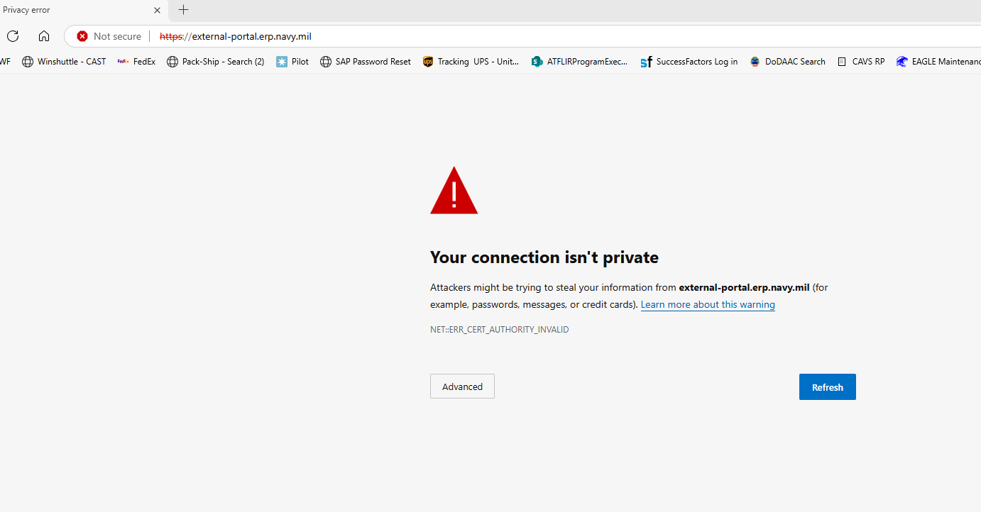
Common RP Access Issues
Your connection isn’t private
The user gets a “Your connection isn’t private” error when they attempt to log into CAV-RP.
Troubleshooting:
The user’s system is missing DOD PKI certificate chains. Work with your local IT team to install the DOD certificates in the system trust store. Contact UM team if issue persists once the certificates are installed on the system.
The IT team can use the InstallRoot 5.6 NIPR 64-bit Windows Installer found at https://www.cyber.mil/pki-pke/tools-configuration-files/ to perform the install.

Slide 24
Common RP Access Issues
Missing Tiles
When you get to the main portal screen, you only see four tiles and cannot access any other transactions.
When a user only sees four tiles, the basic ERP account has been established with no additional access available at this time.
This error usually means the Access Enforcer request is still processing or the required training for the access has not been completed/updated in the system.
User should wait for two business days after they receive the Access Enforcer closure notification email.
If after waiting two business days and they still can’t access the portal functionality, contact your CAV analyst.

Slide 25

Points of Contact / Help
Work through your CAV Analyst first, if they’re unavailable
usn.mechanicsburg.navsupwssmech.mbx.navsup-wss-erp-user-mgmt@us.navy.mil
If you reach this point…You can get a hold of us

